Slide 1
Concepts in DES
OPER 561 Discrete-Event Simulation
Lesson 03
Notes:
Welcome

Slide 2
Learning outcomes: At the end of this course, students will be able to:
LO 1. Construct or modify a simulation model in response to a system description using discrete-event simulation methodology.
LO 2. Differentiate between important and trivial sources of randomness or variability in real-world processes.
LO 3. Describe the theory behind popular random variate generation techniques and understand how they are implemented in computer simulation.
LO 4. Analyze the output of a computer simulation to estimate system performance parameters.
LO 5. Evaluate alternative system designs using simulation.
LO 6. Carry out the process of model verification and validation.
Notes:
I said I’d talk more about these last time and skipped right over them by mistake…
Learning outcomes (objectives, course goals, etc.) are important to me. I work to ensure content and assessments are related to these outcomes. Study guides for tests will reference these a lot. Throughout the course, you should ensure that you are progressing on each of these.

Slide 3
Miscellaneous
Notes:
Any Canvas issues?
Homework - due 4pm. Why not at start of class? Office hour availability.
Check if anyone installed Simio & license status
We’re using Simio in-class next time, bring laptop w/ Simio installed if you think you’ll likely do homework on it.
Current Simio status on lab computer is not what I wanted. We’ll see if it’s fixed in time.
Headcount of who plans to need a lab computer?
Entry Quiz 1 feedback – question 5 (adding a dump truck) gave some troubles, we’ll revisit that after the simulation by hand activity
Questions from last time? Anything else?

Slide 4
Lesson objectives
Discuss underlying ideas, methods, and issues in discrete-event simulation
Practice conceptual modeling
Work with a simulation calendar

Slide 5
Concepts in DES
Discrete-event simulation concepts
Conceptual modeling
DES by hand activity

Slide 6
In discrete-event simulation, a system is modeled in terms of…
a collection of elements that interact toward some logical end
its state at each point in time
the entities passing through the system
the elements representing resources
the events that change the state
Notes:
We defined system last time. Remember that what exactly is the system can depend on goals of study: entire airfield vs. control tower ops. The scope or boundary changes based on goals and can influence what factors/variables are internal vs. external.
Different ways to study a system comes up in HW 1.

Slide 7
System state is the collection of variables that describe the system
It’s a “snapshot” of the system at any time Server idle/busy, # customers in system, …
It should contain enough info to reproduce the system’ configuration/status at that time With respect to the objective of the study
State is changed by events
Notes:
Snapshot, not complete history—could history be a part of the state? Sure, if logic is conditioned on it.

Slide 8
Entities are the “players” that move around the system, change status & affect each other
They are dynamic and there are often multiple instances of the same entity type Like class definitions vs. instances in OOP
They often represent real things Customers, aircraft, machine parts, …
Identifying the entity types is an early step in model development
Notes:
Entities and their behavior & experiences in the system are a primary concern for simulation
Re: real things – sometimes we use “fake” entities for modeling “tricks”, but that’s less common these days as more of those tricks get built into the sim software

Slide 9
Resources are things entities compete for People, equipment, space, …
Entities seize a resource, use it, & release it
A resource is assigned to an entity Not an entity belongs to a resource
A resource has 1+ capacity units & can vary Seats at a restaurant, airline ticketing agents
Notes:
Simulation software like Simio can support resource failure states, too

Slide 10
Activities and delays advance the clock & represent durations when things happen
Activity
Delay
Specified duration known at its start Unconditional wait – e.g., processing time
Unspecified duration based on other events Conditional wait – e.g., time in queue
The definitions work for the event-processing worldview but not so much for other ones
Notes:
Just make note of the distinction for the test. I will almost immediately start using them in their more casual usage. What is important is the notion that some waiting times are set and others depend on events & system state

Slide 11
Variables and attributes are data objects for the characteristics of the system
Variables
Attributes
Global & unique to model, not tied to entities
They are both built-in and user-defined Sim. clock, # parts in system, schedule, …
Local to entities; also built-in & custom Arrival time, due date, priority, repair state…
Entity instances may have different values But all instances of a type have same slots
Notes:
Variables: Entities can access and change variables, as can other elements of the model

Slide 12
Queues are places entities wait, usually for a resource to become available for them to use
Queues can have finite or infinite capacity If finite, need model logic for full queues
They can have various selection rules FCFC, entity priority, entity type, …
Queue length and entity waiting times there are often key measures of interest in a study

Slide 13
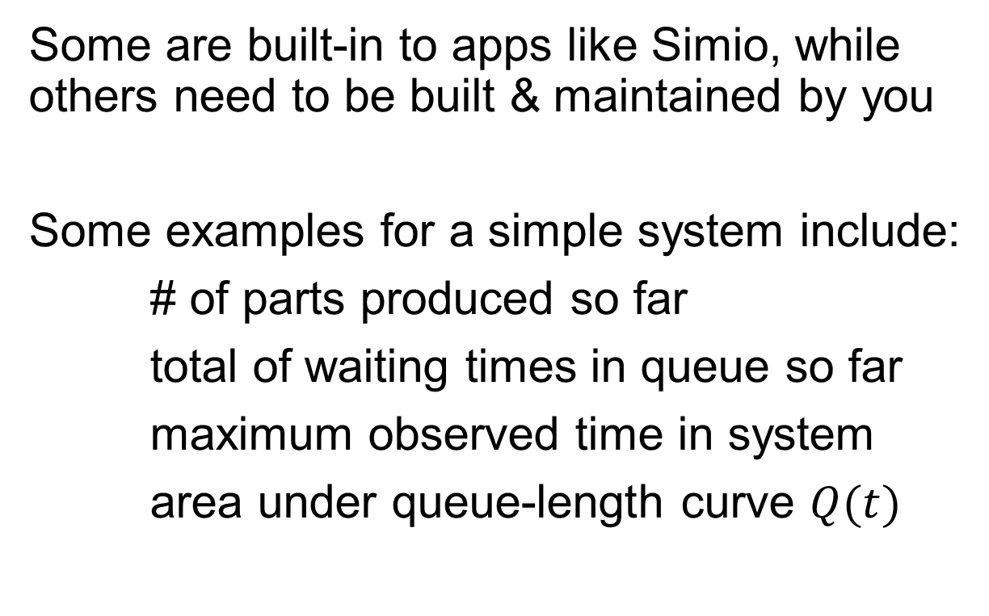
Statistical accumulators watch what happen and are used to find performance measures
Some are built-in to apps like Simio, while others need to be built & maintained by you
Some examples for a simple system include:
# of parts produced so far
total of waiting times in queue so far
maximum observed time in system
area under queue-length curve $Q(t)$
Notes:
The key point is these are not the output/response variables themselves (usually), but they are inputs into the calculation of those responses, e.g., AuC of Q(t) will likely be divided by total time to get mean queue length.

Slide 14
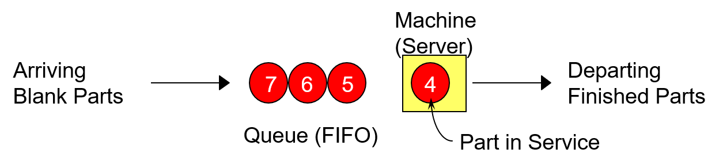
[Example study] Simple processing system
General objectives here are to estimate:
- expected production
waiting time in queue & queue length
proportion of time machine is busy
Assume system begins simulation empty & idle
Notes:
Draw event logic for arrivals & departures on board; will be slightly different than what’s on next slide (that’s okay).

Slide 15
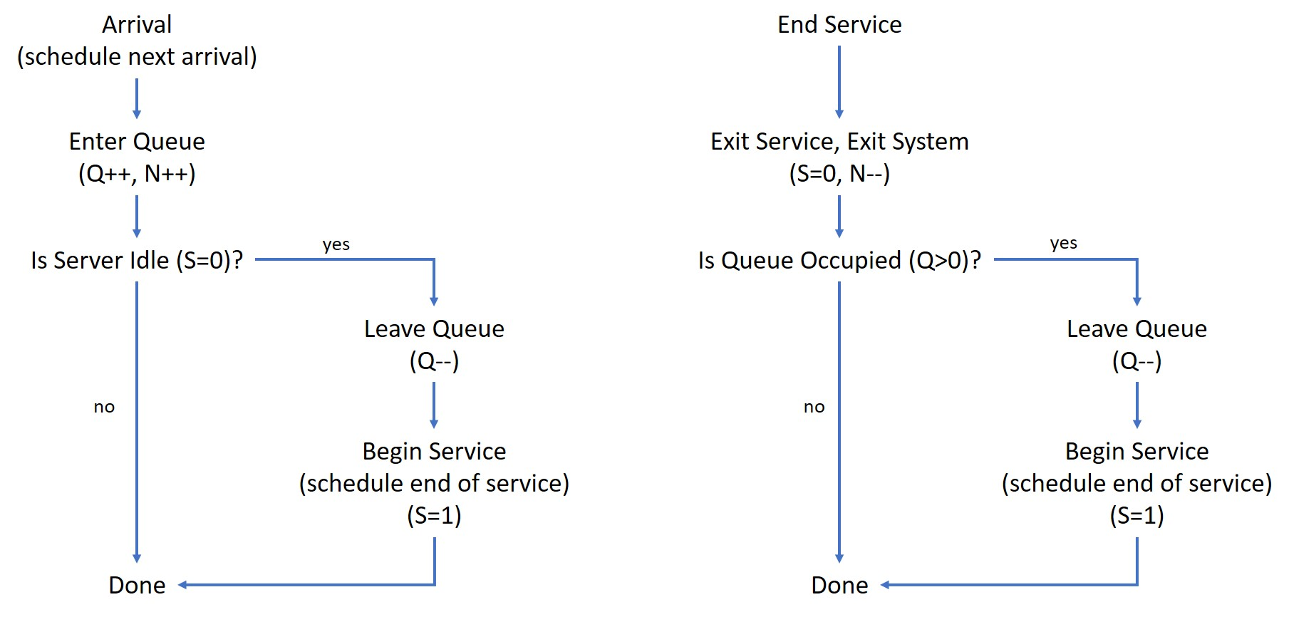
Events alter state & schedule future events
Notes:
Transcribe to board, both for describing in detail now & use later for DES by hand

Slide 16
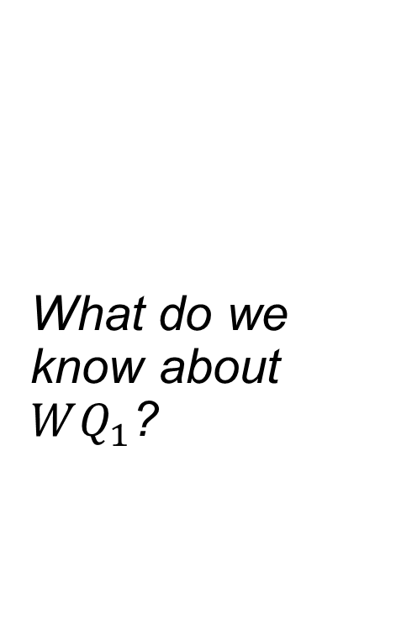
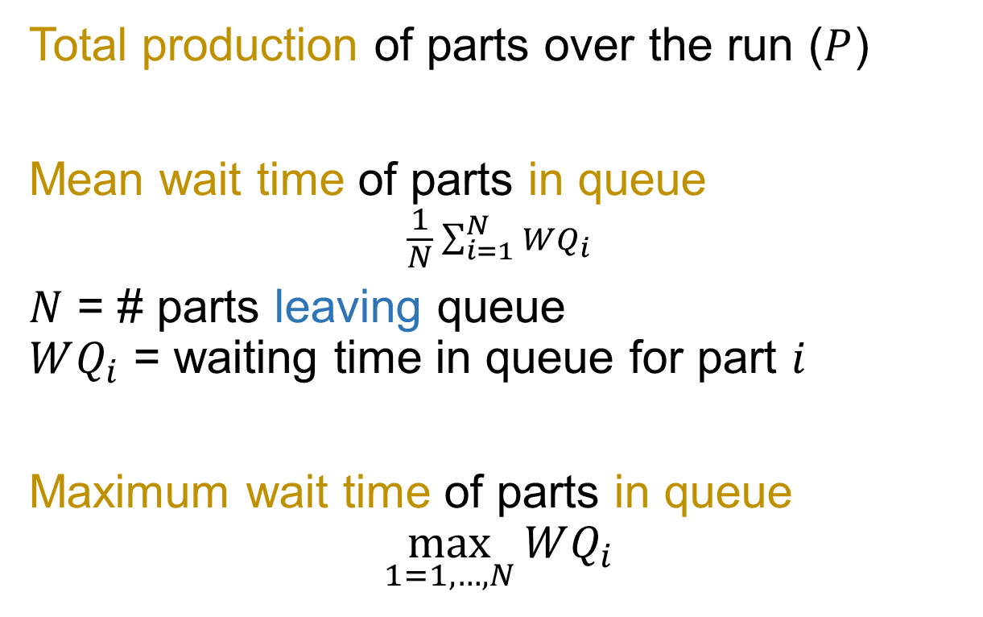
Output performance measures
What do we know about $WQ_{1}$?
Total production of parts over the run ($P$)
Mean wait time of parts in queue
$$\frac{1}{N}\sum_{i=1}^{N}{WQ_{i}}$$
$N$ = # parts leaving queue $WQ_{i}$ = waiting time in queue for part $i$
Maximum wait time of parts in queue
$$\max_{1=1,…,N}{WQ_{i}}$$
Notes:
“leaving” - Important detail to think about…if there are parts in the queue at the end of the simulation, how do we handle those? Large sample size, it probably doesn’t matter so much, & we’ll mostly let the software handle that. But if it matters a lot, then you need to decide what to do.

Slide 17
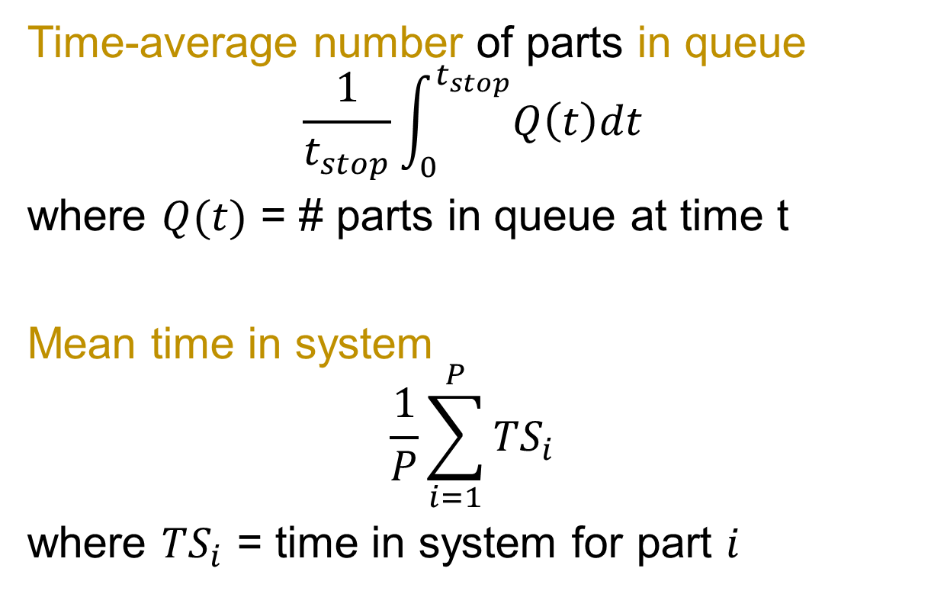
Output performance measures
a.k.a. mean queue length
Time-average number of parts in queue
$$\frac{1}{t_{stop}}\int_{0}^{t_{stop}}{Q\left(t\right)dt}$$
where $Q(t)$ = # parts in queue at time t
Mean time in system
$$\frac{1}{P}\sum_{i=1}^{P}{TS_{i}}$$
where $TS_{i}$ = time in system for part $i$
Notes:
Sidebar: Time-weighted vs. observational statistics—dig into the distinction a bit, maybe draw a graph

Slide 18
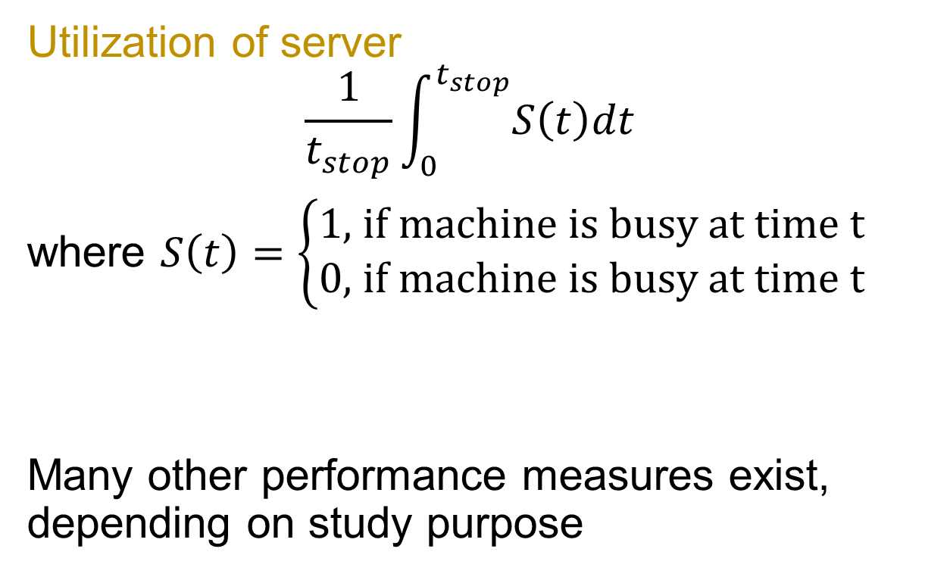
Output performance measures
proportion of time machine is busy
Utilization of server
$$\frac{1}{t_{stop}}\int_{0}^{t_{stop}}{S\left(t\right)dt}$$
where $S\left(t\right)=\left\{\begin{aligned}1\text{,} \text{if} \text{machine} \text{is} \text{busy} \text{at} \text{time} \text{t} \\ 0\text{,} \text{if} \text{machine} \text{is} \text{busy} \text{at} \text{time} \text{t}\end{aligned}\right.$
Many other performance measures exist, depending on study purpose
Notes:
Be careful to avoid information overload through proper prior planning

Slide 19
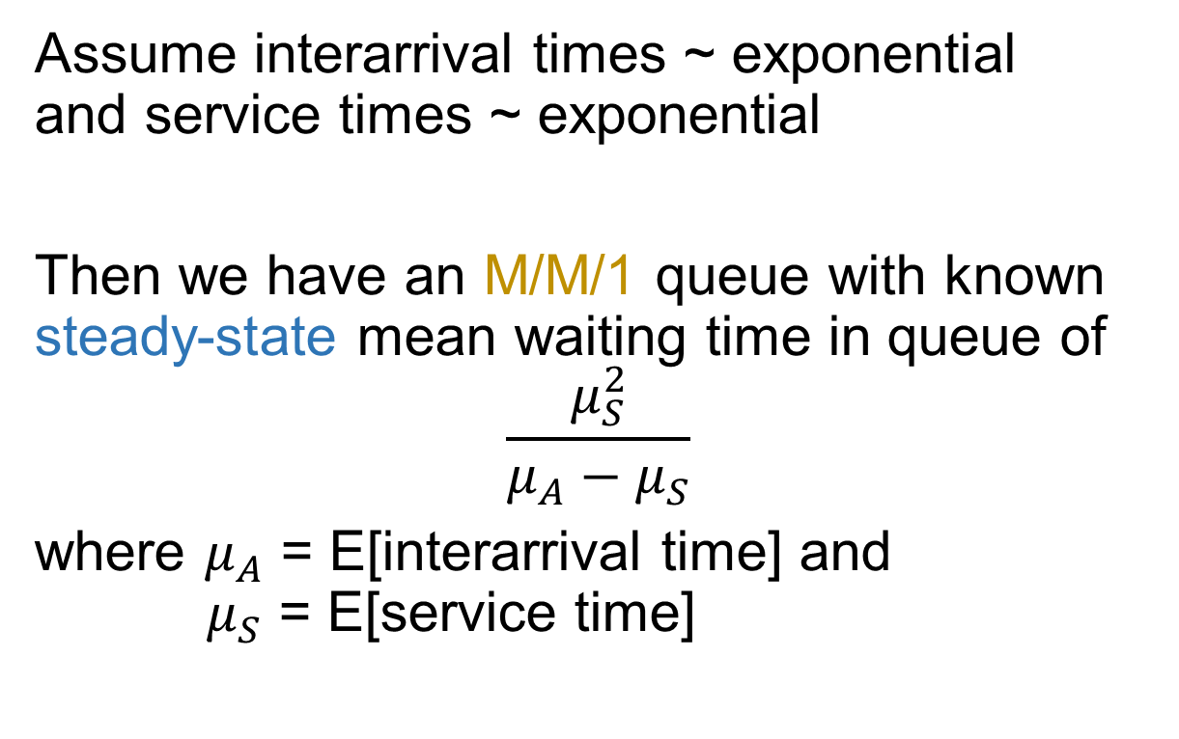
Sidebar: analytic results exist for this example thanks to queueing theory, some assumptions
Queuing theory is often used as an initial approximation
This is a deeper subject in OPER 540
Assume interarrival times ~ exponential and service times ~ exponential
Then we have an M/M/1 queue with known steady-state mean waiting time in queue of
$$\frac{μ_{S}^{2}}{μ_{A}−μ_{S}}$$
where $μ_{A}$ = E[interarrival time] and $μ_{S}$ = E[service time]
Notes:
Steady state: you run the system until t → infinity (or at least long enough that the bias due to starting empty & idle gets small enough)

Slide 20
For simulation, we can make fewer/different assumptions than with the analytic approach
Build the pieces as needed, let them interact, observe the processes, & tally up the results A concrete, “brute force” analysis approach
It’s not mysterious or subtle, but instead it takes much bookkeeping & attention to detail Sim. software handles much, not all, of that

Slide 21
Different simulation world views exist & can influence model/software design
Event scheduling
Process interaction
Activity scanning
Establish initial list of events then add or delete as needed, leaping ahead in time E.g., BCNN dump truck example (3.5)
Similar, but focuses on the entity life-cycle E.g., queueing models, maybe Simio?
At fixed time increments, check all conditions of the system to determine if events trigger
Notes:
This is one taxonomy, others exist. The important point is that there are different perspectives you can take for simulation, and that awareness can lead you to consider other design possibilities.
Event scheduling is easier to do by hand, so that’s what we’ll use later today.

Slide 22
Concepts in DES
Discrete-event simulation concepts
Conceptual modeling
DES by hand activity

Slide 23
Scenario: WPAFB National Road gate ops (Area B) map on next slide
Specifically, we want to build a simulation of the gate operations to:
examine future alternatives for increasing throughput at critical times
examine vulnerabilities that may arise
Notes:
3” Solo: brainstorm any variables, inputs, factors etc. needed to model it
2”: get input from students

Slide 24
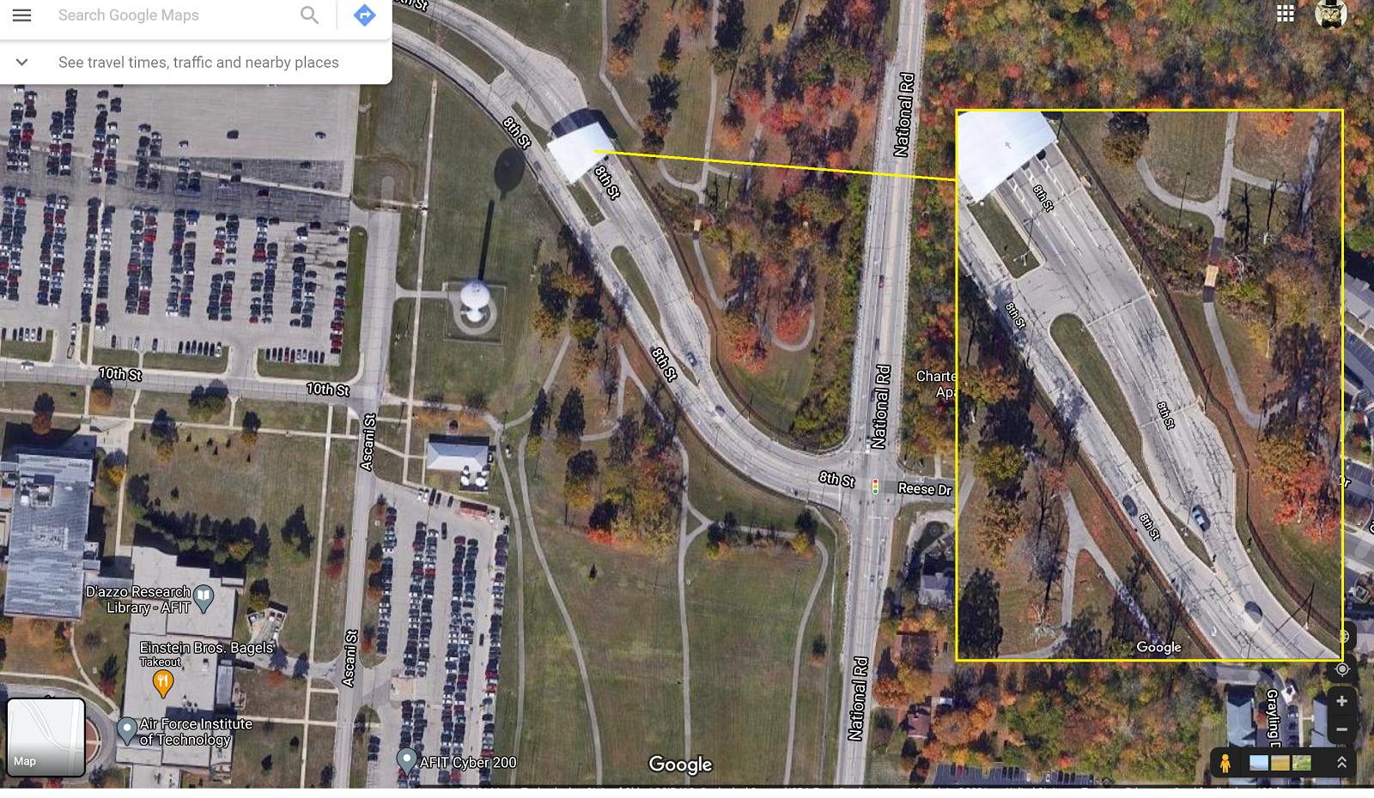

Slide 25
Scenario: WPAFB National Road gate ops (Area B)
Specifically, we want to build a simulation of the gate operations to:
examine future alternatives for increasing throughput at critical times
examine vulnerabilities that may arise
Assume 1 lane open with 1 guard
Objective is to assess mean waiting time for cars and guard utilization during a shift
Notes:
5“ Groups: refine brainstorming to support modeling this specific scenario/objective

Slide 26
System components
Entities Servers
Events Resources etc.
Measures of interest (response variables)
Assumptions
Input parameters
Notes:
4”: have a group write on board & have other groups announce details to add on
Adding a little structure to our conceptual models—use template for board writing
State variables? Assumptions?

Slide 27
break
There’s an Excel file in the activity files folder on Canvas (L03). Download that (everyone).
Notes:
Pause for break

Slide 28
Concepts in DES
Discrete-event simulation concepts
Conceptual modeling
DES by hand activity

Slide 29
Purpose of DES by hand activity:
Develop intuition on how events affect state variables & statistical accumulators
Learn how to read & interpret a simulation event calendar
Notes:
We won’t build one from scratch again, but you will see partial/complete calendars and need to add an event or two and read them to compute response variables.

Slide 30
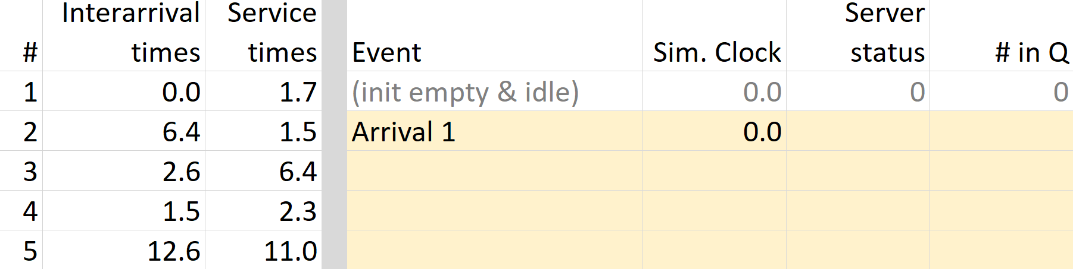
Scenario: base gate, single lane/single guard
Goals: find mean # in system, queue length, and resource (guard) utilization
Go to Excel workbook
Notes:
Similar sort of structure to the textbook examples, but we’ll take a trimmed-down approach. The textbook’s methods are great for if you’re writing a DES from scratch in programming, but a little overkill for our purposes.
About 15 minutes, long enough to get bored, but not quite to tears... Questions?
After: visit quiz question 5 re: Ex 3.5

Slide 31
Scenario: WPAFB National Road gate ops (Area B)—enhanced
Now, assume 1-3 lanes are open, each with 1-2 guards, & both can vary with time
Any new measures of interest?
Changes to state variables?
New events? Modified event logic?
New assumptions?
Remember: start simple & add complexity
Notes:
Students group-work for several minutes, I’ll interject with questions, repeat.
Opening/closing lane rules (event logic)
Queue movement (balk/reneg/jockeying)
Batching of inbounds
Backups off base / backups after guards
Realism & support of alternatives
Handling anomalies
Wrap up around 0932.

Slide 32
Concepts in DES
Discrete-event simulation concepts
Conceptual modeling
DES by hand activity
Notes:
Before stopping, let’s talk briefly about simulation stopping conditions: time, condition, or empty calendar. The last one is technically true but not very interesting, though it will make a nice exam question…

Slide 33
Lesson objectives
Discuss underlying ideas, methods, and issues in discrete-event simulation
Practice conceptual modeling
Work with a simulation calendar
Notes:
Next time: Simio Lab 1, I suggest you set up Simio on a personal computer for best results. Note the readings & quiz. HW 1 is due 4pm. Any questions?

Slide 34
Learning outcomes: At the end of this course, students will be able to:
LO 1. Construct or modify a simulation model in response to a system description using discrete-event simulation methodology.
LO 2. Differentiate between important and trivial sources of randomness or variability in real-world processes.
LO 3. Describe the theory behind popular random variate generation techniques and understand how they are implemented in computer simulation.
LO 4. Analyze the output of a computer simulation to estimate system performance parameters.
LO 5. Evaluate alternative system designs using simulation.
LO 6. Carry out the process of model verification and validation.

